Slide 1
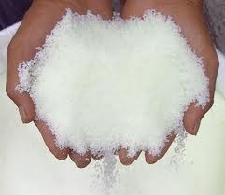
PRODUCTION OF UREA
Presented by
Mr. George Tani Hooke King
Mr. Kadingdi Forsyth Awedana
Mr. Ousmane Kabo

Slide 2
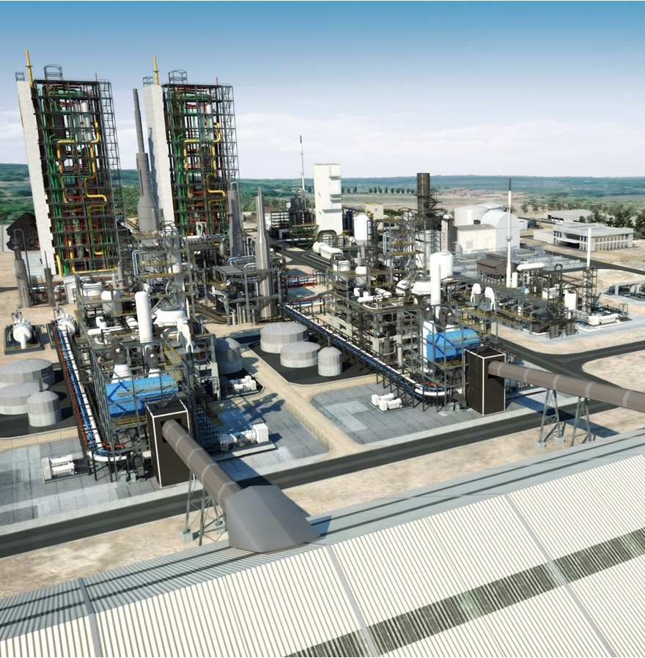
INTRODUCTON AND PROCESS SELECTION

Slide 3



INTRODUCTION
Urea is an organic compound also known as carbamide
It IUPAC name is Diaminomethanal
Chemical formula: (NH₂)₂CO
Functional group: amide(-NH₂ ) and carbonyl (C=O)

Slide 4
HISTORY
Urea was thought to be an organic compound that can only be synthesized by living organism.
Urea was first discovered in urine in 1773 by the French chemist Hilaire Rouelle.
Urea was first synthesized from inorganic raw materials by a German chemist Friedrich Wöhler obtained urea by treating silver isocyanate with ammonium chloride in 1828.
AgNCO + NH₄Cl → (NH₂)₂CO + AgCl

Slide 5
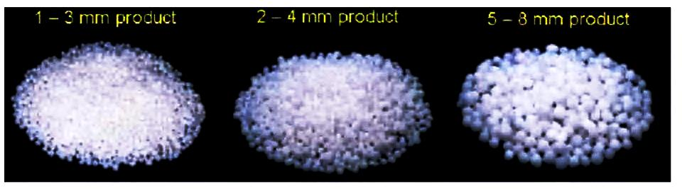
PHYSICAL AND CHEMICAL PROPERTIES USES OF UREA

Slide 6
PHYSICAL PROPERTIES OF UREA
Urea is an odourless solid
Density | 1.33·10³ kg/m³, solid
Melting point | 132.7 °C (406 K) decomposes
Boiling point | NA
Solubility in water | 108 g/100 ml (20 °C) 167 g/100 ml (40 °C) 251 g/100 ml (60 °C) 400 g/100 ml (80 °C) 733 g/100 ml (100 °C)
Vapour pressure | <0.1 hPa
Bulk density | 0.8 kg.m⁻³

Slide 7
CHEMICAL PROPERTIES OF UREA
Forms hydrogen bonding
Molecular shape is planar
Has a molecular weight of 60.07g/mol
Dipole moment is 4.56p/D
pH is ( 100g.L⁻¹ in water, 20ºC) ~9

Slide 8
USES OF UREA
Agricultural use
Industrial use
Medical use
Textile use
Laboratory use
Commercial use

Slide 9
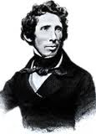
TYPES OF SYNTHESIS
Physiological synthesis from amino acids.
Laboratory synthesis from basic inorganic materials like silver isocyanate and ammonium chloride.
Industrial Production.
Friedrich Wöhler
1828

Slide 10
INDUSTRIAL PRODUCTION OF UREA
Urea is synthesized from it raw materials in two steps.
combination of ammonia and carbon dioxide at high pressure to form ammonium Carbamate.
dehydration by the application of heat to form urea and water.

Slide 11
PROCESS SELECTION
Several processes are used to manufacture urea known as BAT (Best Available Techniques) processes.
Conventional technologies.
Modern technologies .

Slide 12
PROCESS SELECTION
Some of the widely used urea production BAT processes are:
1. Conventional processes
2. Stamicarbon CO2 – stripping process
3. Snamprogetti Ammonia and self stripping processes
4. Isobaric double recycle process
5. ACES (Advance Cost for Energy Savings) process

Slide 13
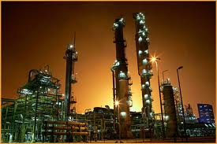
PROCESS DESCRIPTION AND FLOW SHEETS
ACES PROCESS

Slide 14
ADVANCE COST FOR ENERGY SAVINGS PROCESS
ACES process was developed by Tokyo Engineering Corporation.
Performs better than carbon dioxide stripping, ammonia stripping and all other processes.
Accepted and used in Europe and America.
Consist of the reactor, two carbamate condensers, a stripper and a scrubber.

Slide 15
REASON WHY ACES IS PREFERED
ACES process is preferred to all the others for the following reasons:
Less HP piping and construction materials
Easier erection using commonly available construction equipment and techniques
Easier operation supported

Slide 16
REASON WHY ACES IS PREFERED
Easier maintenance
Less energy consumption
lower production cost per metric ton of urea
Has high urea yield per and high purity

Slide 17
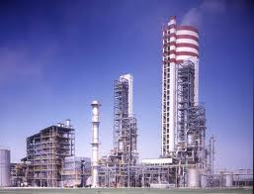
STAGES OF UREA PRODUCTION
There are four main stages in the production of urea namely:
Synthesis
Purification
Concentration
Granulation and or Prilling
An auxiliary stage in the production is the Process Water Sources and Quantities.

Slide 18
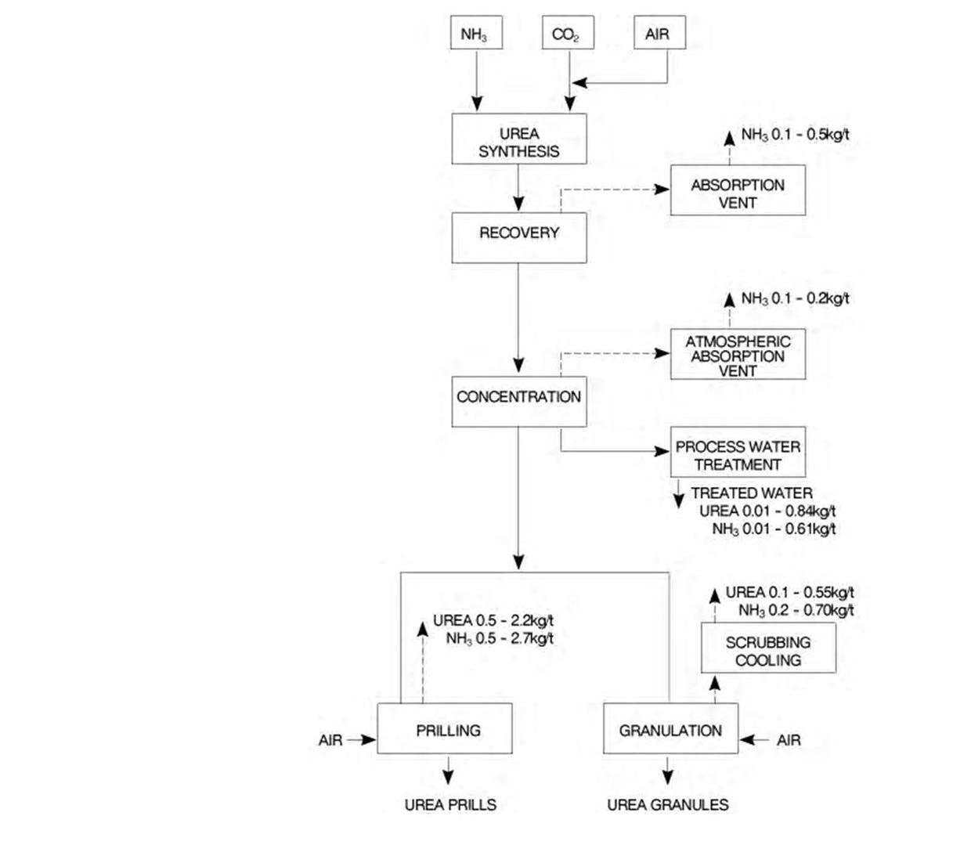
SCHEMATICS

Slide 19
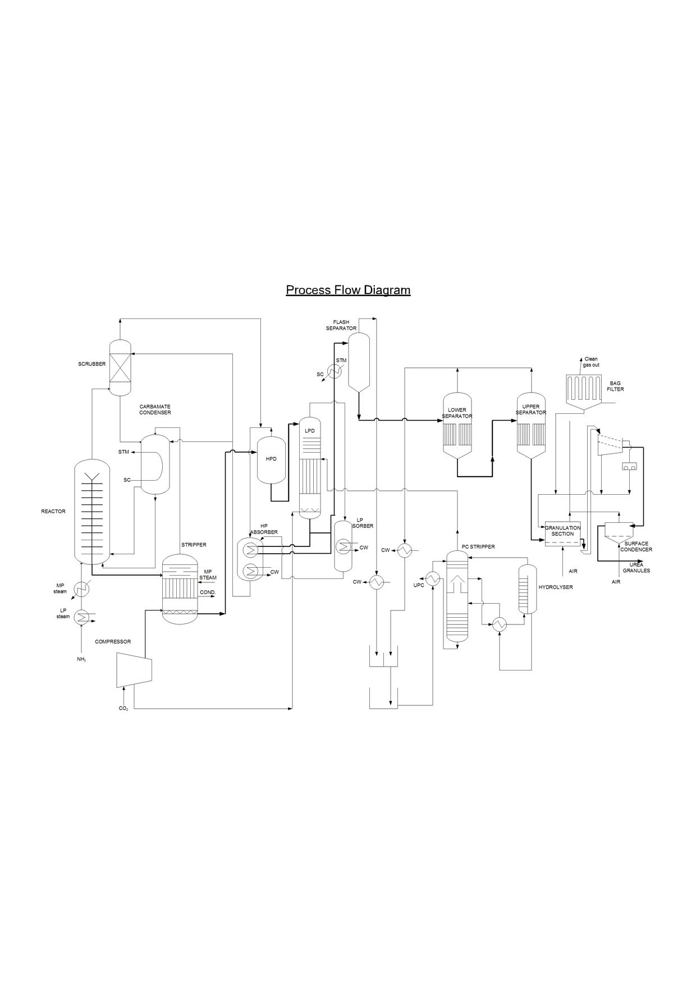

Slide 20
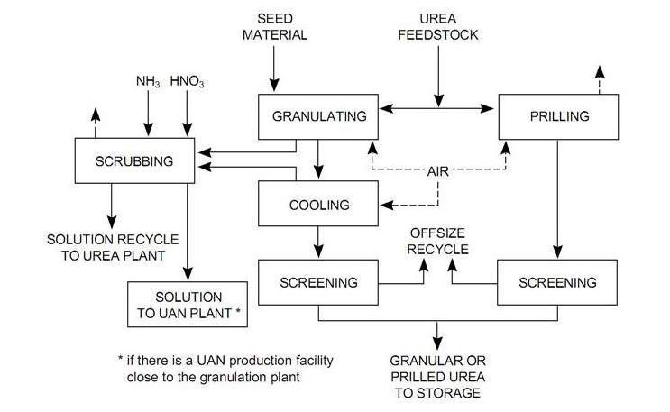
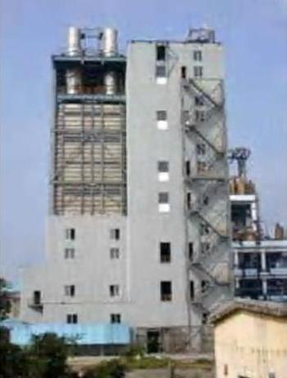
GRANULATION /PRILLING SCHEMATICS

Slide 21
Main component of the process
Reactor
2NH₃ + CO₂ ↔ NH₂ COONH₄ +heat Δ H = - 84 kJ/mol
NH₂COONH₄ + heat ↔ NH₂CONH₂ + H₂O ΔH = +23 kJ/mol
Stripper
NH₂COONH₄+ heat ↔ 2NH₃ + CO₂ ΔH = +84 k/mol
NH_{3(l)} ↔ HN_{3(g)}
Carbamate Condenser
2NH₃ + CO₂ ↔ NH₂COONH₄ + heat ΔH = -84 kJ/mol
NH₃(g) → NH₃(l)

Slide 22
Medium Pressure Decomposer
NH₂COONH₄ + heat ↔ 2NH₃ + CO₂ ΔH = +84 kJ/mol
NH_{3(l)} → NH_{3(g)}
Low Pressure Decomposer
NH₂COONH₄ + heat ↔ 2NH₃ + CO₂ ΔH = +84 kJ/mol
NH_{3(l)} → NH_{3(g)}
Medium Pressure Absorber
2NH₃ + CO₂ ↔ NH₂COONH₄ + heat ΔH = -84 kJ/mol
Low Pressure Absorber
2NH₃ + CO₂ ↔ NH₂COONH₄ + heat ΔH = -84 kJ/mol
Flash Separator
H₂O_{(l)} → H₂O_{(g)}

Slide 23
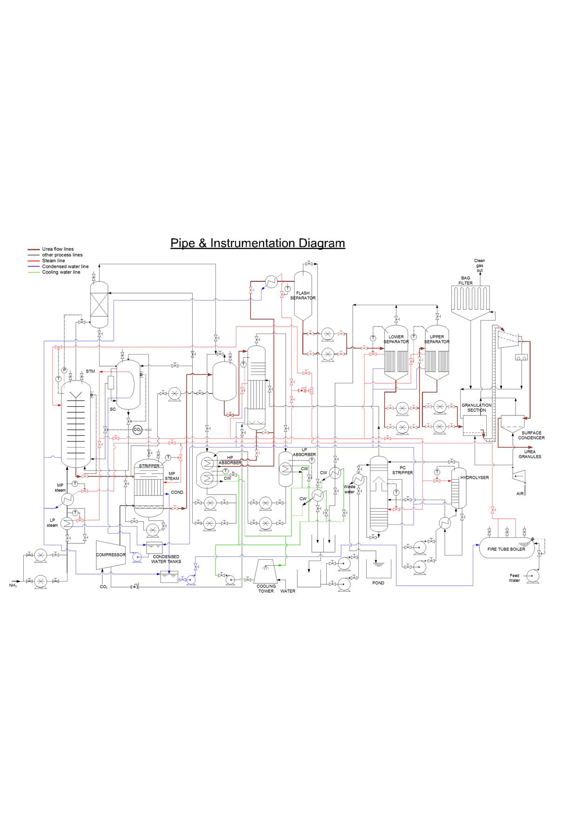

Slide 24
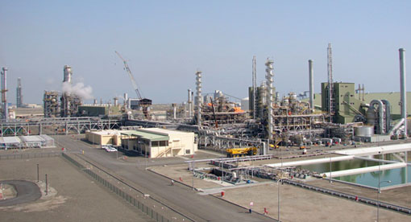
THAN K YOU

